Slide 1
DATA STRUCTURES
Algorithm Analysis

Slide 2
Session Objectives
To learn
Running time calculations for iterative algorithms
Notes:
Student Notes:
The objective of the session is to introduce the concept of services and how these are management. There are standards and frameworks that enable the organization to manage the services. These are also introduced in this session.

Slide 3
Session Outcomes
At the end of this session, participants will be able to
Understand how to calculate the approximate running time of the algorithm
Calculate approximate running time for the given algorithm

Slide 4
Agenda
Introduction to algorithms
Discussion of examples to calculate their running time

Slide 5

Algorithm Analysis
Dr. B. Prabavathy
SSNCE

Slide 6
Introduction
For any problem, we will have one or more solutions
Solution can be described as algorithms
These algorithms will be analyzed for their time and space complexity
Later, an algorithm which has better time complexity will be converted into program in a specific language to solve the problem

Slide 7
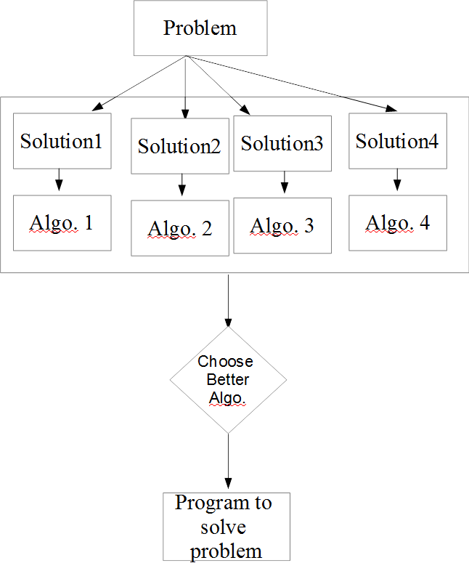
Introduction – contd.

Slide 8
Algorithms
Iterative
If the algorithm has looping statement
Recursive
If the algorithm has recursive function
No way one algorithm is better than the other
Both the algorithms are the same with their working

Slide 9
Calculation of running time for algorithms
If algorithm does not have iteration or recursion, then it takes constant time O(1)
There is dependency for the running time w.r.t the input size
Iterative algorithm
Count the number of times the loops in the algorithm will run
Recursive algorithm
Use recurrence relation to find running time

Slide 10
Example 1
for(i=1;i<=n;i++)
print(“Welcome to SSN”);
Loop will run for n times
Hence time → O(n)

Slide 11
Example 2
for(i=1;i<=n;i++)
for(j=1;j<=n;j++)
print(“Welcome to SSN”);
Loop will run for n*n times
Hence time → O(n²)

Slide 12
Example 3
i=1, s=1
while (s<=n)
{
i++
s=s+i
print(“Welcome to SSN”)
}
Running time of this algo. depends on how many times the while loop will run
For i=1, s=1
For i=2, s=3
For i=3, s=6
For i=4, s=10
Let us assume, after k iterations, the condition will be reached
When k(k+1)/2 >n, k²>n
Hence, k is
Running time is O( )

Slide 13
Example 4
for(i=1;i²<=n;i++)
print(“Welcome to SSN”);
How many times this loop will run?
For n=9,
i=1, 1²<=9, i=2, 2²<=9, i=3, 3²<=9
Hence, the loop runs for
So, the time is O( )
We can rewrite algo. as follows
for(i=1;i<= ;i++)
print(“Welcome to SSN”);

Slide 14
Example 5
int I,j,k,n;
for(i=1;i<=n;i++)
for(j=1;j<=i;j++)
for(k=1;k<=100;k++)
print(“Welcome to SSN”);
How many times the loops will run?
i loop runs for n times,
j loop runs - ?
k loop runs for 100 times
for i=1,
j loop - 1 time,
k loop for 100 times
1*100 times
for i=2,
j loop - 2 times,
k loop for 100 times
2*100 times
for i=n,
j loop - n times,
k loop for 100 times
n*100 times
1*100+2*100 + … + n*100
100*(1+2+… n)
100*n(n+1)/2
=O(n²)

Slide 15
Example 6
int I,j,k,n;
for(i=1;i<=n;i++)
for(j=1;j<=i²;j++)
for(k=1;k<=n/2;k++)
print(“Welcome to SSN”);
How many times the loops will run?
i loop runs for n times,
j loop runs - ?
k loop runs for n/2 times
for i=1,
j loop - 1² time,
k loop for n/2 times
1² *n/2 times
for i=2,
j loop - 2² times,
k loop for n/2 times
2² *n/2 times
for i=n,
j loop – n² times,
k loop for n/2 times
n² *n/2 times
1² *n/2+ 2² *n/2 + … + n² *n/2
n/2*(1² + 2² +… n²)
n/2*n(n+1)(2n+1)/6
=O(n⁴)

Slide 16
Example 7
for(i=1;i<=n;i*=2)
print(“Welcome to SSN”);
1,2,4,…..n
2⁰, 2¹, …. 2^{k}
It is 2^{k} = n
Hence, k= log₂n
Running time is O(log₂n)

Slide 17
Example 8
for(i=n/2;i<=n;i++)
for(j=n/2;j<=n;j++)
for(k=1;k<=n;k*=2)
print(“Welcome to SSN”);
i loop will run for n/2 times
j loop will run for n/2 times
k loop will run for log₂n times
Hence, n/2*n/2*log₂n times
= O(n² log₂n)

Slide 18
Example 9
for(i=n/2;i<=n;i++)
for(j=1;j<=n;j*=2)
for(i=k;k<=n;k*=2)
print(“Welcome to SSN”);
i loop will run for n/2 times
j loop will run for log₂n times
k loop will run for log₂n times
Hence, n/2*(log₂n)² times
= O(n² (log₂n)²)

Slide 19
Example 10
for(i=1;i<=n;i++)
for(j=1;j<=n;j=j+i)
print(“Welcome to SSN”);
i loop will run for n times
j loop step value is based on i
i=1
j=1 to n times, as step is 1
so n times
i=2
j incremented in step is 2
so n/2 times
i=3
j incremented in step 3
n/3 times
n+n/2+n/3+ … n/n
= n[1+1/2+1/3+ … 1/n]
= O(n(log n))

Slide 20
Simple Questions
What is the running time of the algorithm if it is not involving iteration or recursive function?
What are the types of algorithms?
Whether non-linear data structure will consume lesser time when compared with linear data structure?

Slide 21
Summary
Introduction to algorithms
Discussion of examples to calculate their running time

